Slide 1
Claims

Slide 2
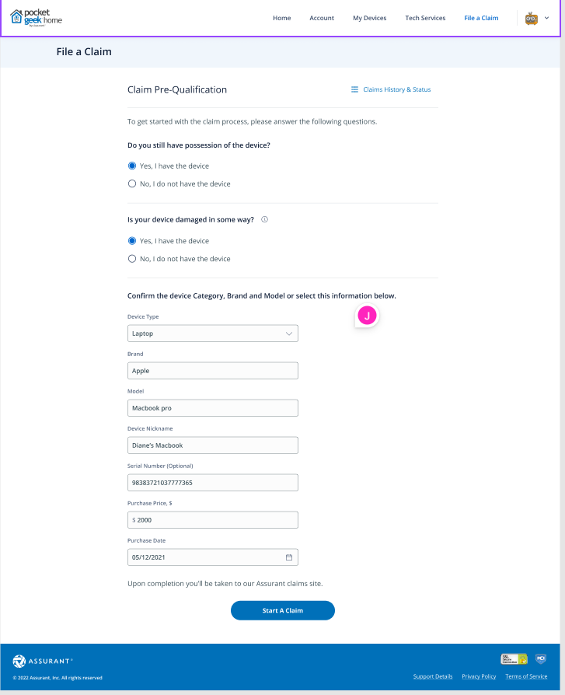
Notes:
Expand to full width. – could not done.
2. Proper spaces between textboxes and labels.
3. Add claims history & status.

Slide 3
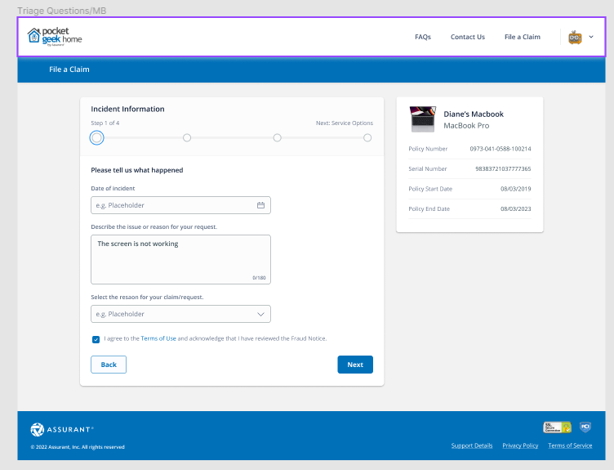

Slide 4
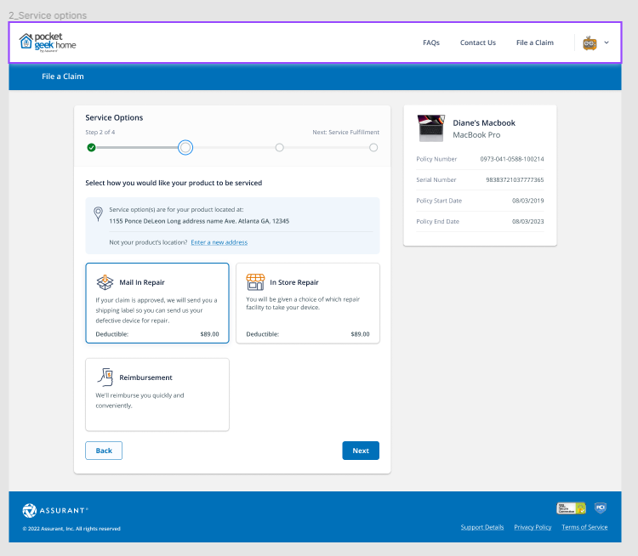

Slide 5
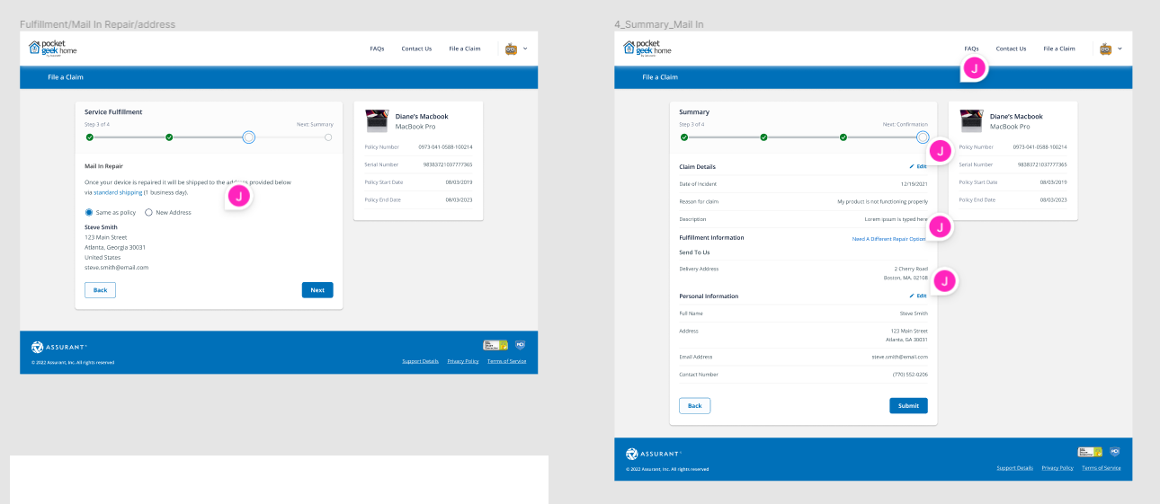

Slide 7
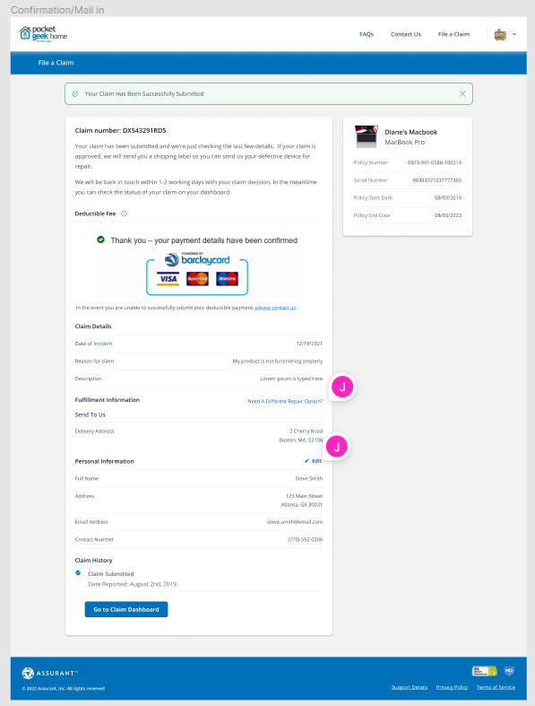

Slide 8
Thank you

